Slide 1

<DNS Home Appliance V1.0>
Hardware: very low power for always-on (<4W = 5€/year)
  i.e. ARM/Raspberry PI Zero or RISC-V/Mango.
Install an OS of choice and a local recursive resolver
  i.e. KnotResolver, unbound or similar
Load “.” Root-zone for faster startup and offload Root-servers
  https://www.iana.org/domains/root/files
Overall number of DNS requests served in 2022: 6,7Mio (!)
  For only 4-5 devices (PC, Mobile, TV and Notebook)
Change local gateway/DHCP server to new DNS-Server: done
By Kurt Kayser Konsultation

Slide 2
Keep DNS requests inhouse
Do not send local requests to slow/sluggish provider services or to big operators such as Google/and the like
Speed DNS lookup
  feels like 2-3 times faster for complex news pages that may contain 100+ elements
Avoid DNS censorship and maximize local control
Analysis is fun (LED flashing on DNS requests!)
  i.e. when changing channels on a smart TV
  LED hardware is 1x150Ohm resistor and an LED +10 lines of python code on 2 dedicated GPIO pins
By Kurt Kayser Konsultation

Slide 3
Effects
Really fast Webpage loading
Really fast Mobile-Apps loading
Really fast SW-updates
General feeling of more control (perception and security?)
Check about IPv6 connectivity (+ Browser Plugin IPfoo)
Block unwanted destinations locally (i.e. 8.8.8.8/8.8.4.4 ?)
By Kurt Kayser Konsultation

Slide 4
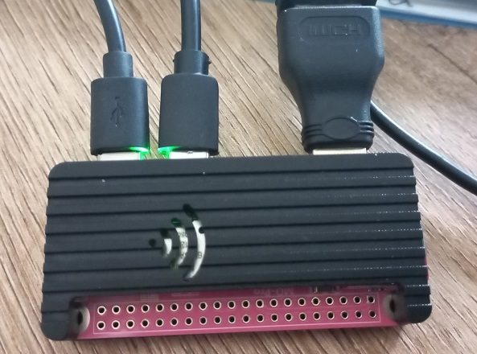
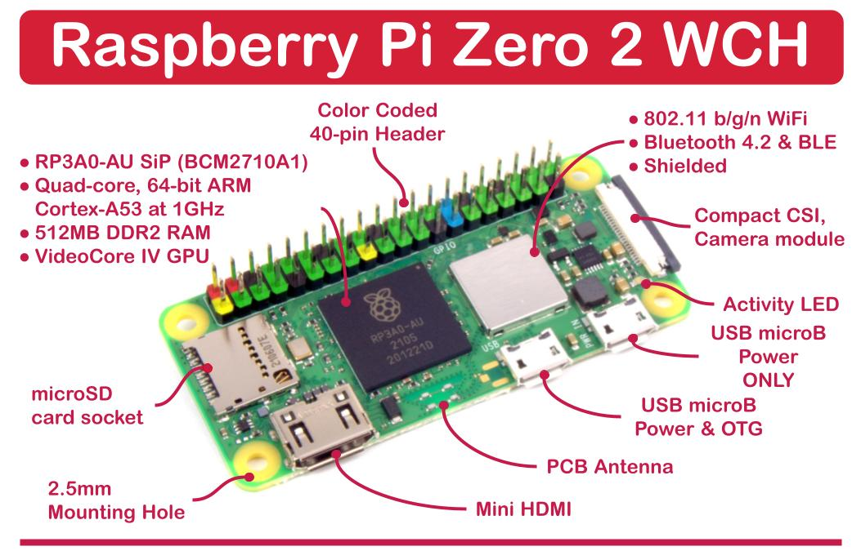
FUTURE WORKS
Compare commercial solutions
Build a real appliance or a full-image (live-OS no install?)
Look for errors and strange behavior
By Kurt Kayser Konsultation

Slide 5
Link collection 4 reference and start
HW: RISC-V
  https://mangopi.org/mqpro
HW: ARM
  https://www.raspberrypi.com/products/raspberry-pi-zero-w/
  https://www.berrybase.de/en/raspberry-pi-zero-wh
SW: OS
  Raspbian/Armbian, Debian or Ubuntu
SW: DNS
  https://www.linuxlinks.com/best-free-open-source-dns-servers/
  https://cloudinfrastructureservices.co.uk/top-20-best-open-source-dns-servers-for-linux-windows/
  https://www.nlnetlabs.nl/projects/unbound/about/
  https://www.knot-resolver.cz/
By Kurt Kayser Konsultation

